Slide 1
Pixels for Policy Making The Africa Knowledge Platform
Stephen Peedell
European Commission Joint Research Centre

Slide 2
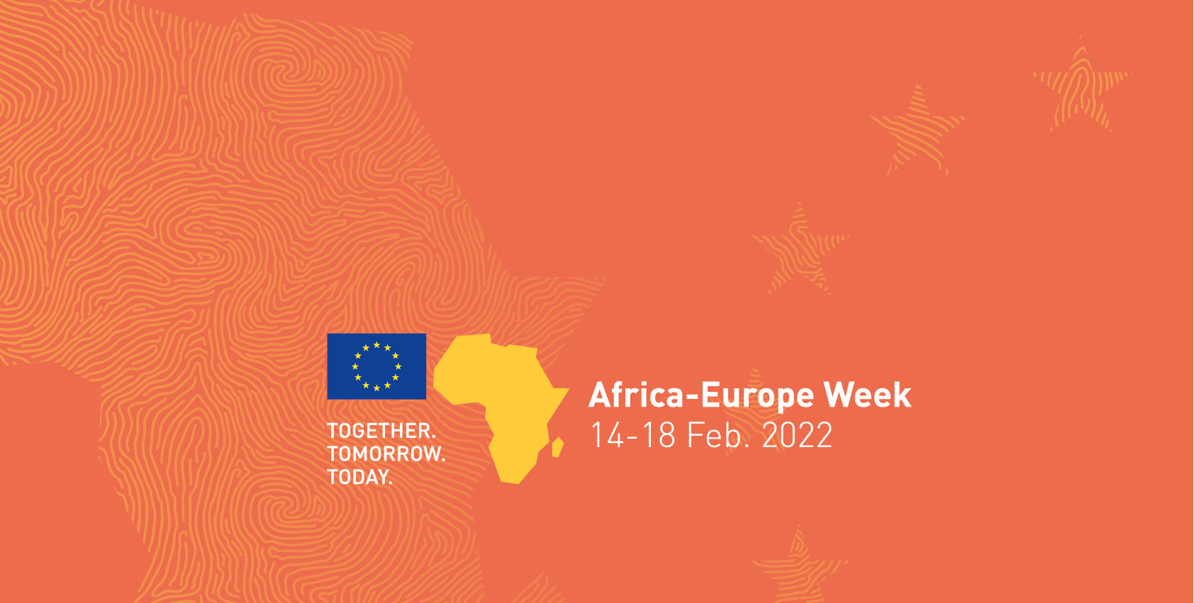
Pixels for Policy Making The Africa Knowledge Platform
Harnessing EO towards Resilient & Sustainable systems, communities & resources
The 6th AfriGEO Symposium
31st Oct – 5th Nov, 2022
Notes:
A new platform, created by the JRC, launched at Africa Week at the AU-EU Summit in February 2022. Hundreds of datasets, from our projects and partnerships, linked to policies stemming from the AU-EU Partnership and broader Global Gateway inititative

Slide 3
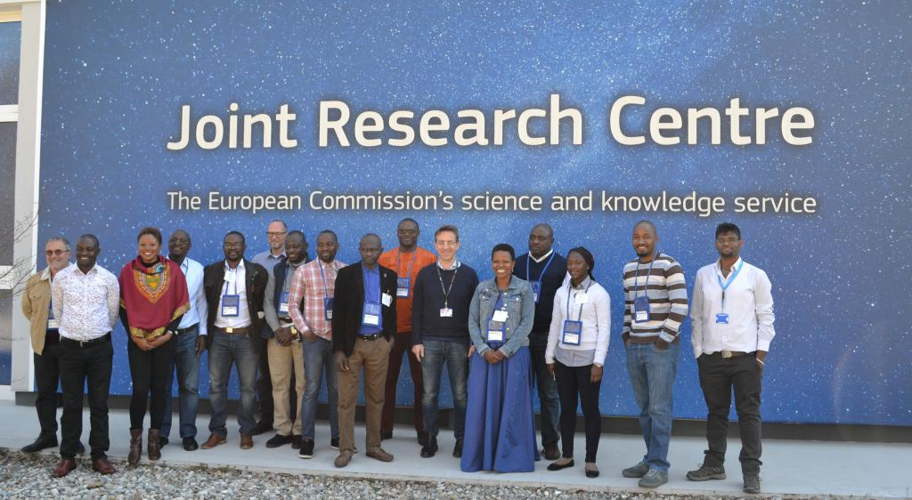
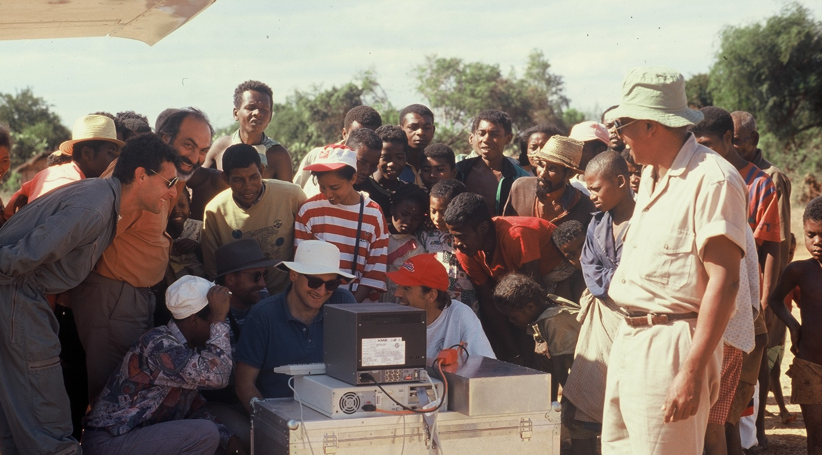
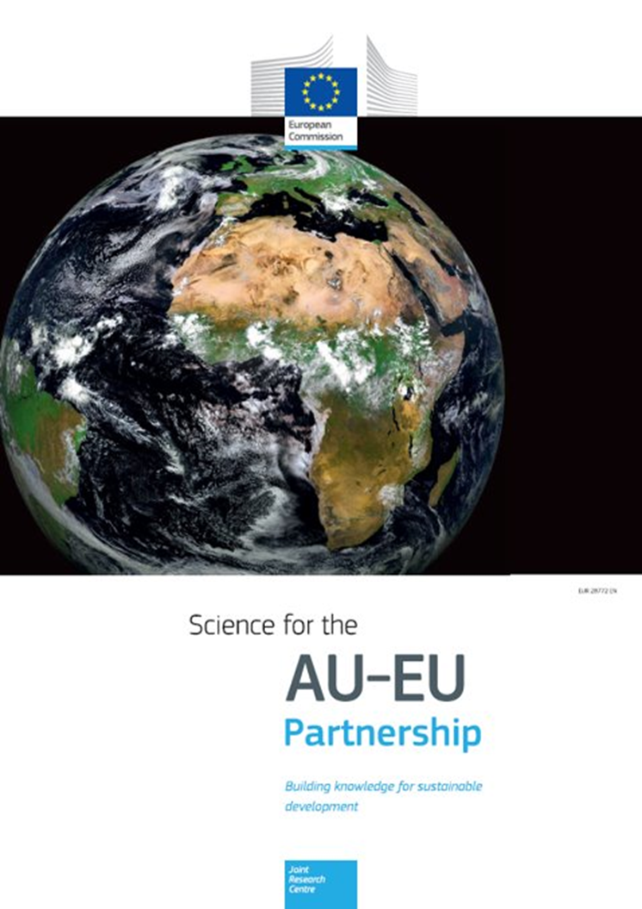
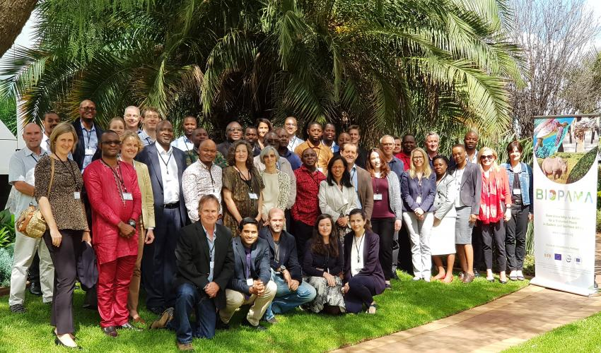
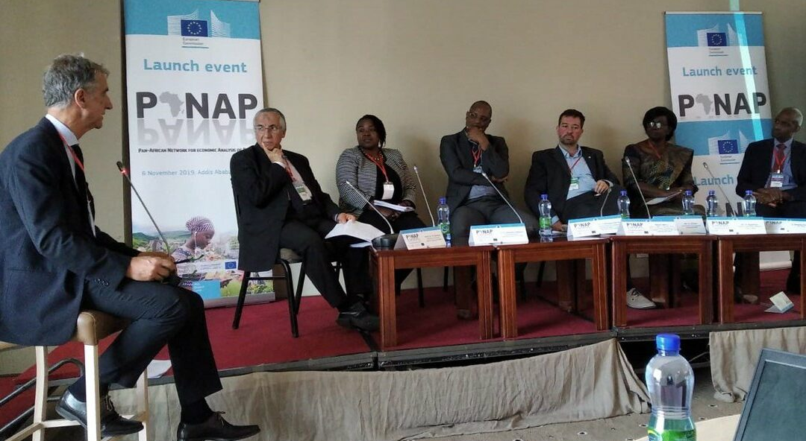
A long tradition of scientific partnership with Africa
Harnessing EO towards Resilient & Sustainable systems, communities & resources
The 6th AfriGEO Symposium
31st Oct – 5th Nov, 2022
Notes:
In 2017, ahead of the 5th AU-EU Summit, the Joint Research Centre of the European Commission summarised three decades of scientific collaboration with its partners in Africa into one report “Science for the AU-EU Partnership - Building knowledge for sustainable development “
Remote Sensing applications were very much at the core of this work with Africa, leading to major programmes such as GMES and its Africa component, and all of the partnership around space that has remained a major thematic area.

Slide 4
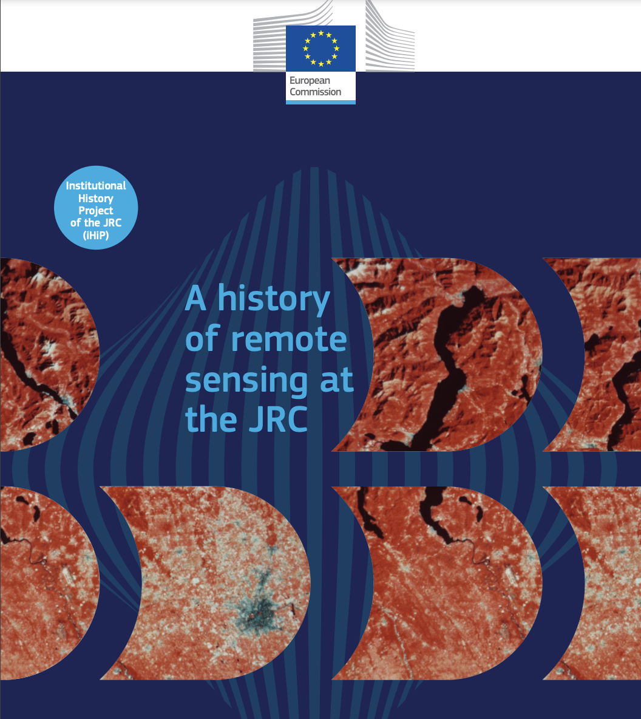
JRC Remote Sensing Tradition
The 6th AfriGEO Symposium
31st Oct – 5th Nov, 2022
Notes:
For almost 50 years, the JRC has been working on using remote sensing to inform policy
The JRC has helped shape numerous European policies using remote sensing technology. Its scientists have added to the sum of knowledge on key issues, such as rates of global deforestation, desertification, water resources, and urbanization. Teams have produced data sets that help assess progress towards the 2030 sustainable development goals. Others have produced compliance and assurance systems that reduce errors in public spending to below
the materiality threshold. The JRC’s remote sensing services provide vital input to humanitarian aid, help reduce disaster risks, and provide help in post disaster recovery. The JRC also played a significant part in establishing Copernicus, a world-class Earth Observation programme.

Slide 5
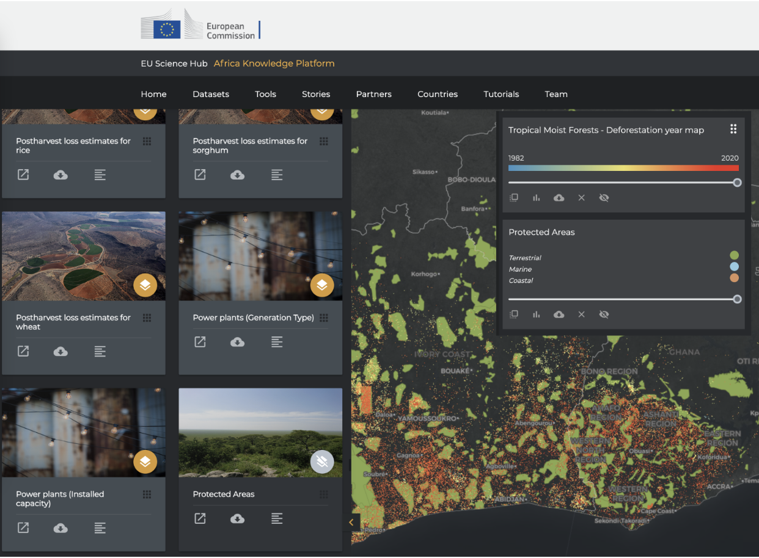
AKP – A Visual, Interactive Data Catalogue
The 6th AfriGEO Symposium
31st Oct – 5th Nov, 2022
Notes:
Over 230 datasets that can be visualised and queried
Statistics can be generated and downloaded
Open data, mostly coming from JRC projects, predominantly geospatial, much of which comes from earth observation

Slide 6
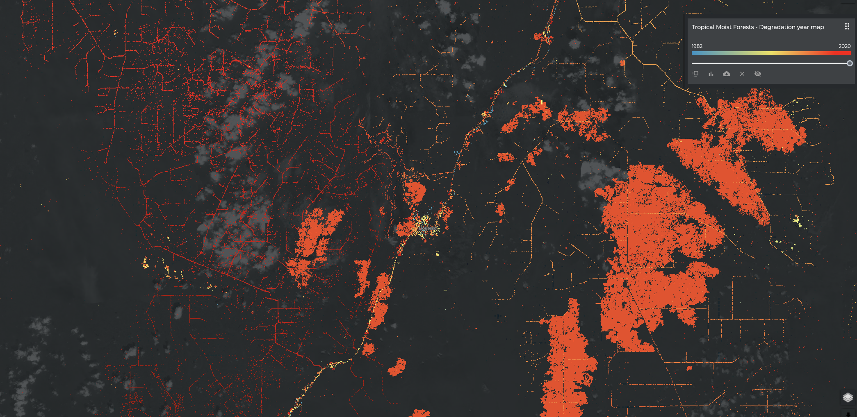
Flagship EO data products and services
The 6th AfriGEO Symposium
31st Oct – 5th Nov, 2022
Notes:
AKP features several flagship EO data products (as online interactive maps and downloadable data) e.g. Tropical Moist Forest loss and degradation, Global Surface Water Explorer, Global Humnan Settlement Layer, Copernicus Hotspot

Slide 7
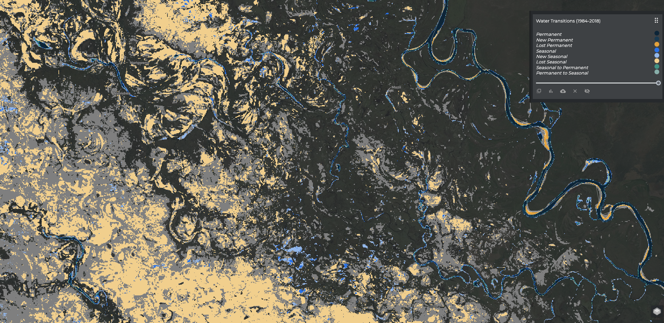
Flagship EO data products and services
The 6th AfriGEO Symposium
31st Oct – 5th Nov, 2022
Notes:
Global Surface Water Explorer

Slide 8
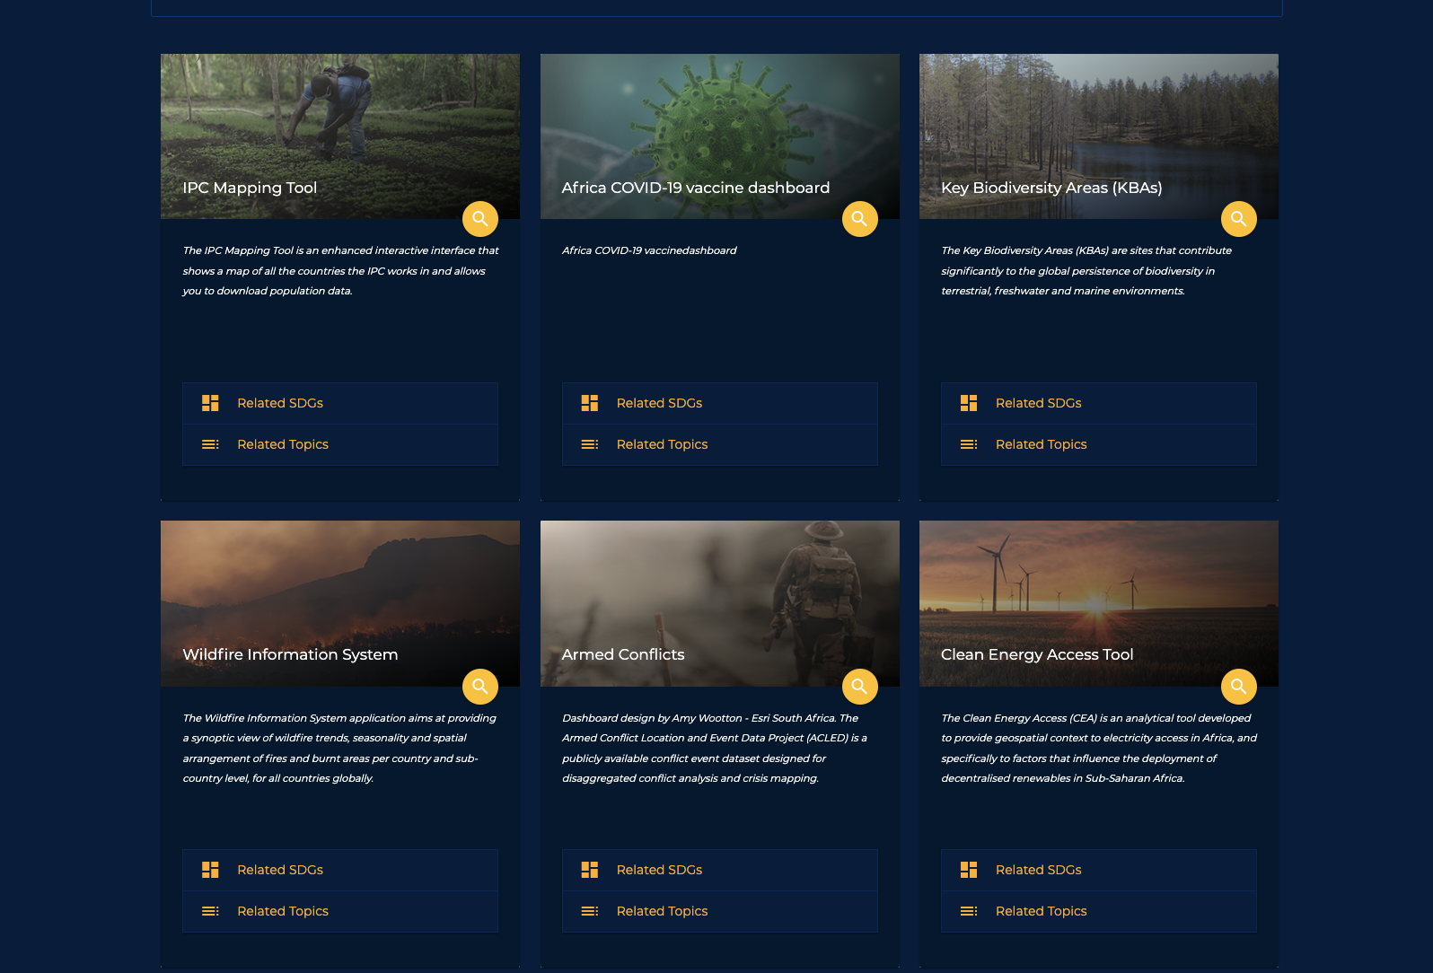
Thematic Tools
The 6th AfriGEO Symposium
31st Oct – 5th Nov, 2022
Notes:
A series of thematic tools are embedded in AKP covering a wide range of applications

Slide 9
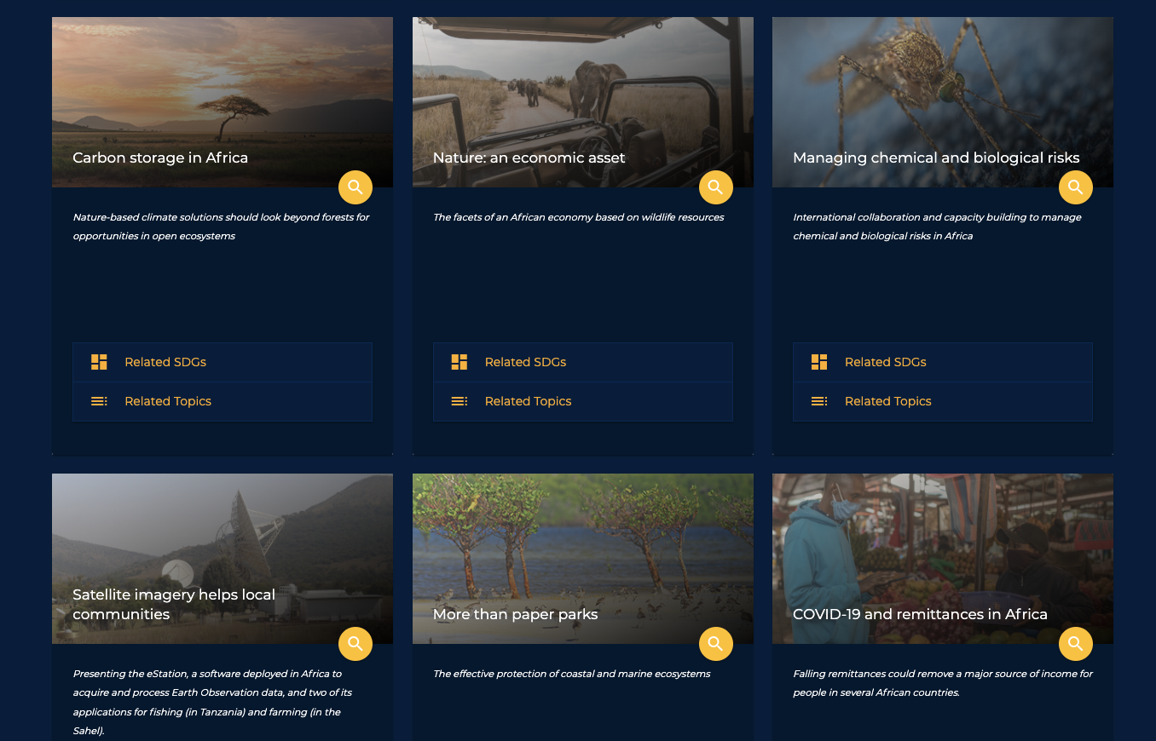
Narratives - StoryMaps
The 6th AfriGEO Symposium
31st Oct – 5th Nov, 2022
Notes:
StoryMaps are simple, powerful, communication tools that combine interactive maps and text narratives, with photos, video etc to explain what we do

Slide 10
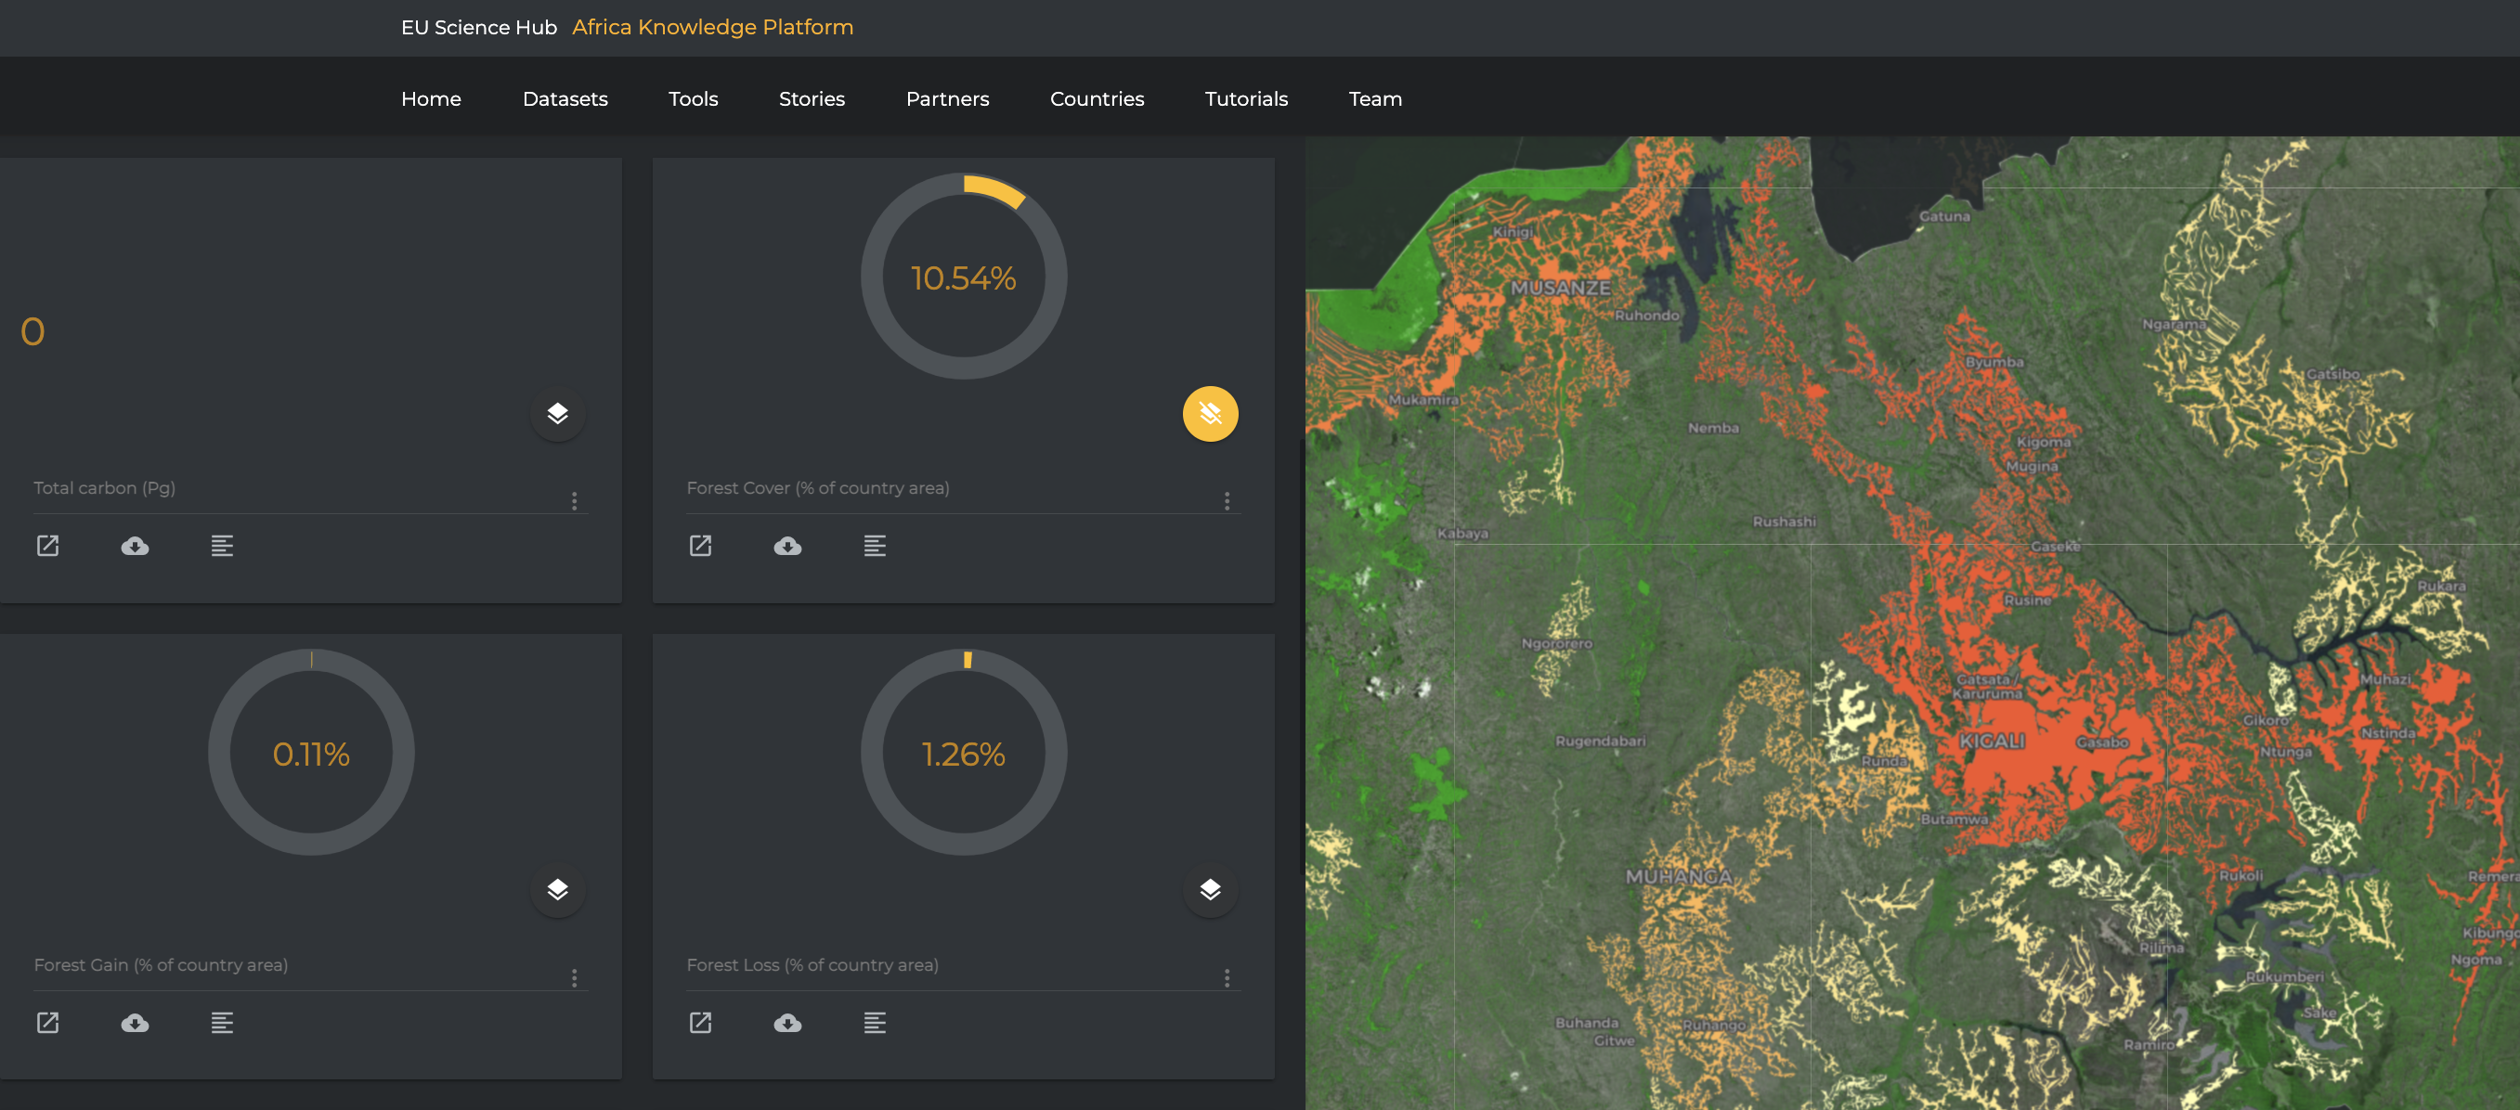
Country Profiles
The 6th AfriGEO Symposium
31st Oct – 5th Nov, 2022
Notes:
Simple country level statistics and indicators

Slide 11
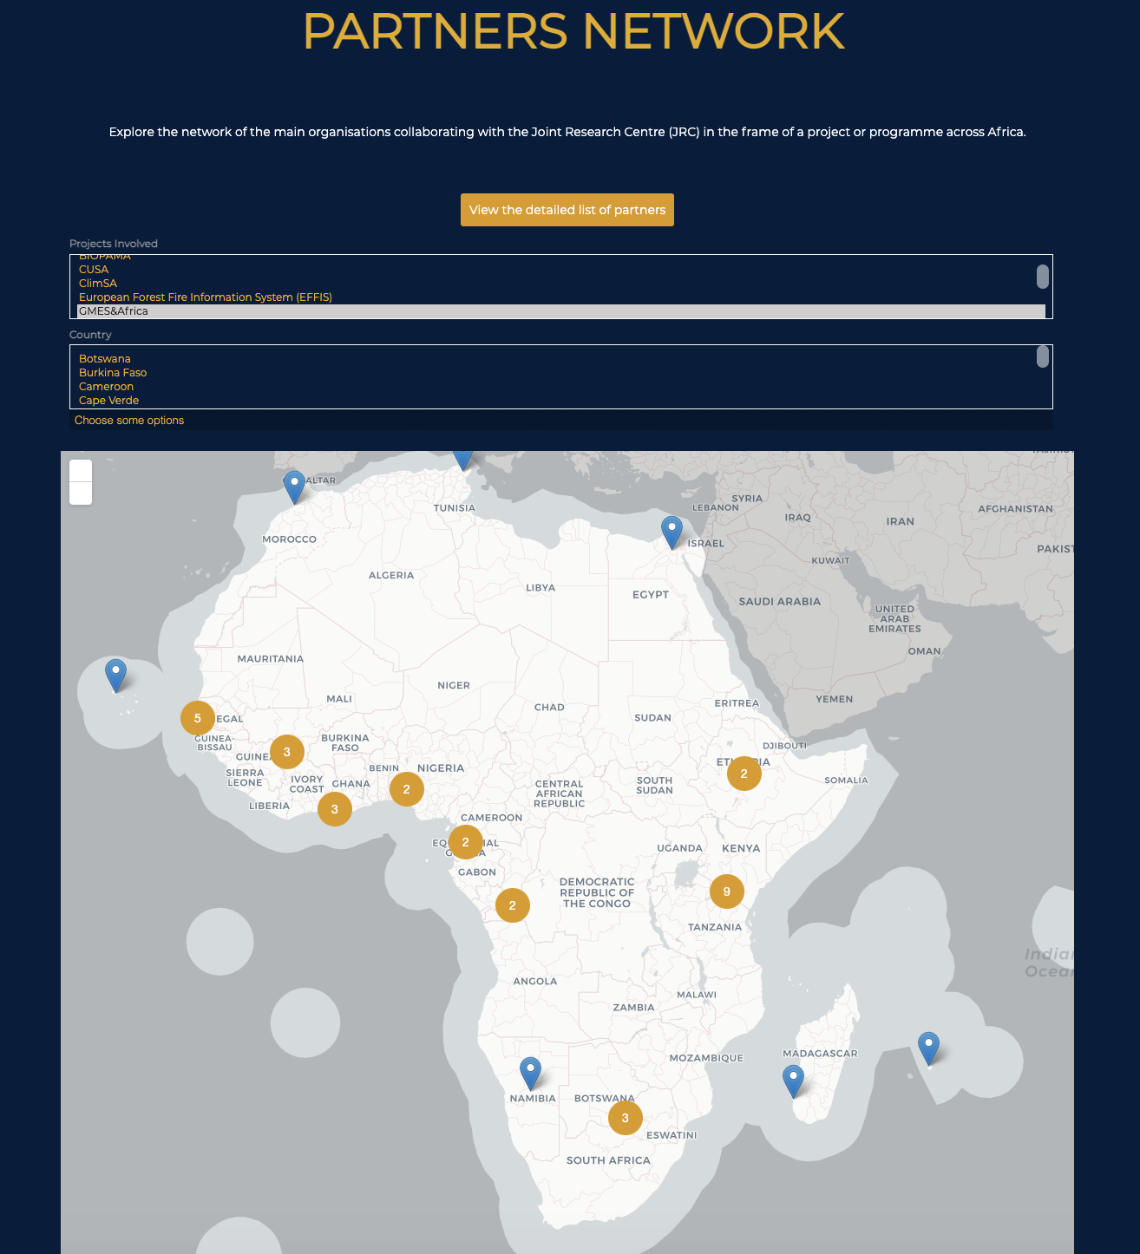
Partners
The 6th AfriGEO Symposium
31st Oct – 5th Nov, 2022
Notes:
We are mapping who we work with on which projects, in which countries

Slide 12
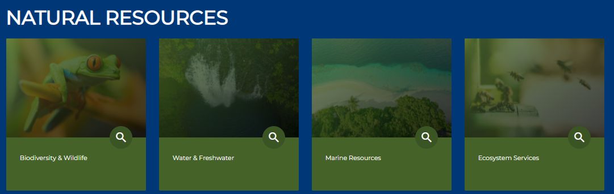
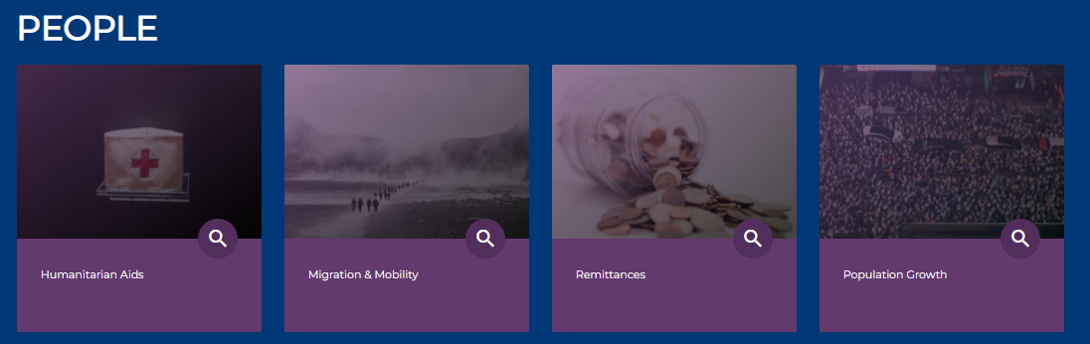
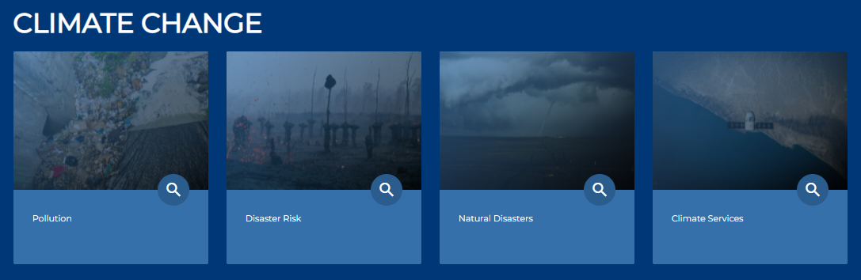
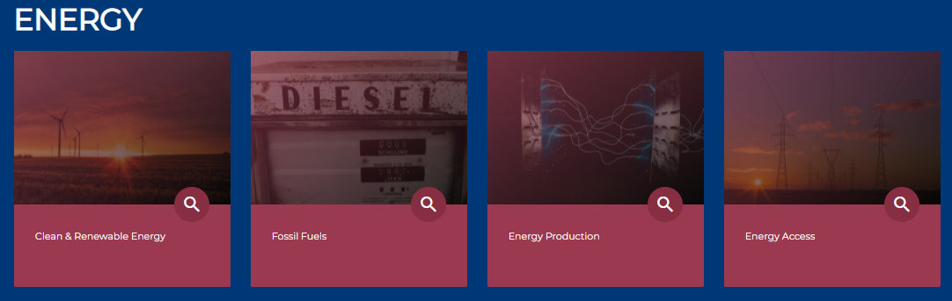
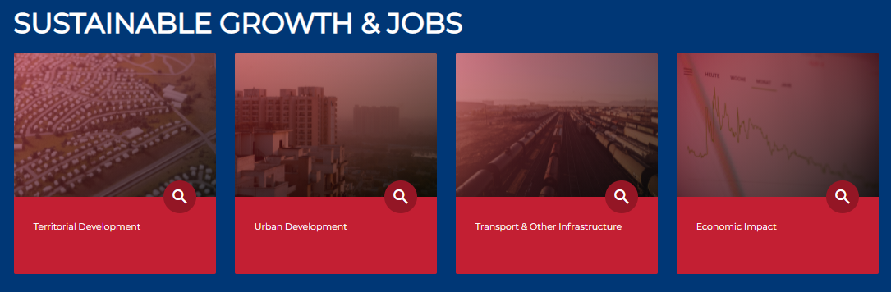
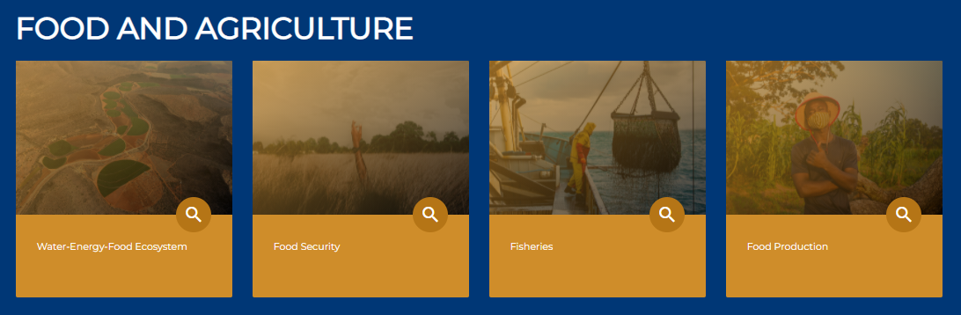
From sectoral research to multidisciplinary knowledge
The 6th AfriGEO Symposium
31st Oct – 5th Nov, 2022
Notes:
AKP has a powerful multidisciplinary capability, over 60 topics are featured and it is easy to combine data and visualise

Slide 13
Next steps – an AKP User and Development Community
The 6th AfriGEO Symposium
31st Oct – 5th Nov, 2022

Slide 14
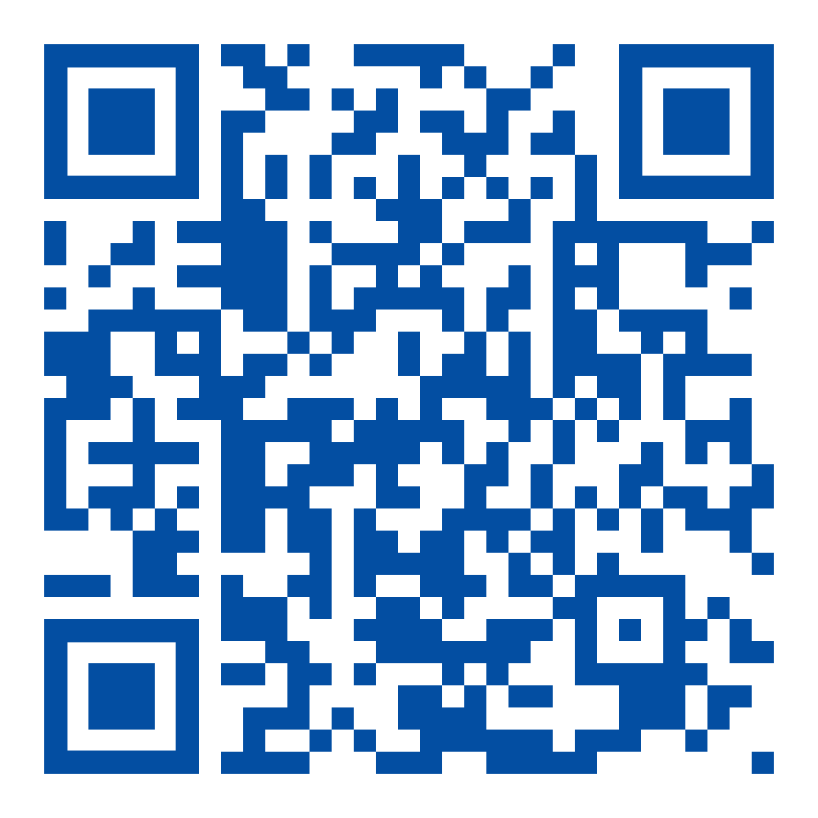
Check out the platform, and get involved...
Visit the platform at: https://africa-knowledge-platform.ec.europa.eu
Contact us: JRC-AFRICA@ec.europa.eu
The 6th AfriGEO Symposium
31st Oct – 5th Nov, 2022

Slide 15
Thank you
© European Union 2022
Unless otherwise noted the reuse of this presentation is authorised under the CC BY 4.0 license. For any use or reproduction of elements that are not owned by the EU, permission may need to be sought directly from the respective right holders.
Notes:
Update/add/delete parts of the copy right notice where appropriate.
More information: https://myintracomm.ec.europa.eu/corp/intellectual-property/Documents/2019_Reuse-guidelines%28CC-BY%29.pdf

Slide 16
Questions?

